Slide 1
ALASR Improvement Hearing
ALASD Maintenance/Training Facility
December 5, 2023
7:00 PM

Slide 2
Current ALASR Board
Joel Dahlheimer, Chair – Alexandria Township
Bill Krivanek – Carlos Township
Ben Johnson – LaGrand Township
Jeff Tvrdik – Hudson Township

Slide 3
ALASD vs. ALASR
ALASD – Alexandria Lake Area Sanitary District
ALASR – Alexandria Lake Area Service Region
Areas of Carlos, LaGrand, Alexandria and Hudson Townships within the ALASD boundary
Separate Governmental Entities- work together on sewer extensions
Shared Vision and Purpose:
Protect public health, safety & welfare of the Alexandria lake region
Preservation & best uses of water & natural resources – i.e., protection of Alexandria Area Lakes from urban pollution
Regional approach to sanitary sewer collection and treatment
Efficient and economic collection, treatment & disposal of wastewater through centralized treatment systems

Slide 4
ALASR vs. ALASD (cont’d)
ALASD:
Maintains all wastewater collection, conveyance, & treatment facilities
Authority to establish regulations governing wastewater collection & treatment systems
Responsible for construction of treatment works and interceptor sewer
Authority to set user fees and tax levy (LGU Tax Allocation)
ALASR:
Joint Powers Board
Established in 1976 through enabling legislation (ALASD established in 1971)
Responsible for planning and construction of lateral (local) sewer lines within the four township boundaries

Slide 5
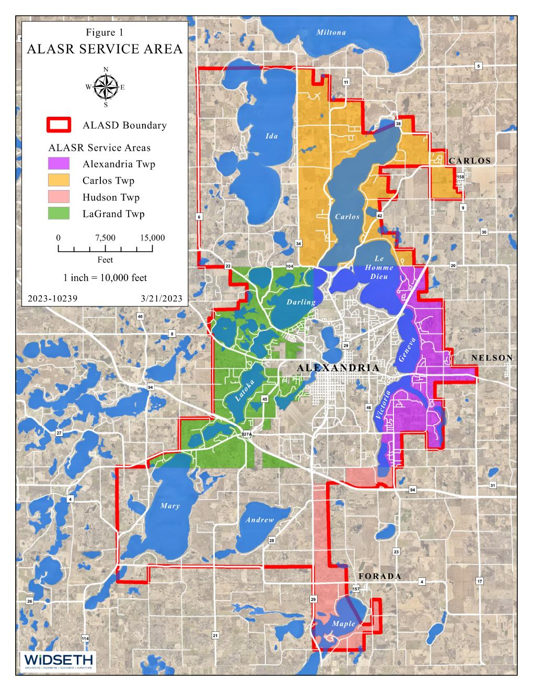
ALASR Service Area

Slide 6
Project to Date
ALASR board identified areas in need of public sanitary sewer based on public inquiries, board requests & ALASD staff recommendations (2021 Comprehensive Plan)
Township informational meetings were held to inform officials of potential sewer extension project areas
ALASR ordered Feasibility Report
Approved by the ALASR board on September 21, 2023
Improvement Hearing for affected property owners-December 5, 2023

Slide 7
Future Steps
Each township board will need to pass a resolution ordering the sewer extension improvement project initiated by ALASR
A final ALASR Board approved resolution ordering the ALASR sewer extension (within six months after the date of the Improvement Hearing)
New areas cannot be added to the project
Individual project areas can be removed from the project
A second hearing (Assessment Hearing) will be held following project bidding to give benefitting property owners an opportunity to comment on the actual assessment amount

Slide 8
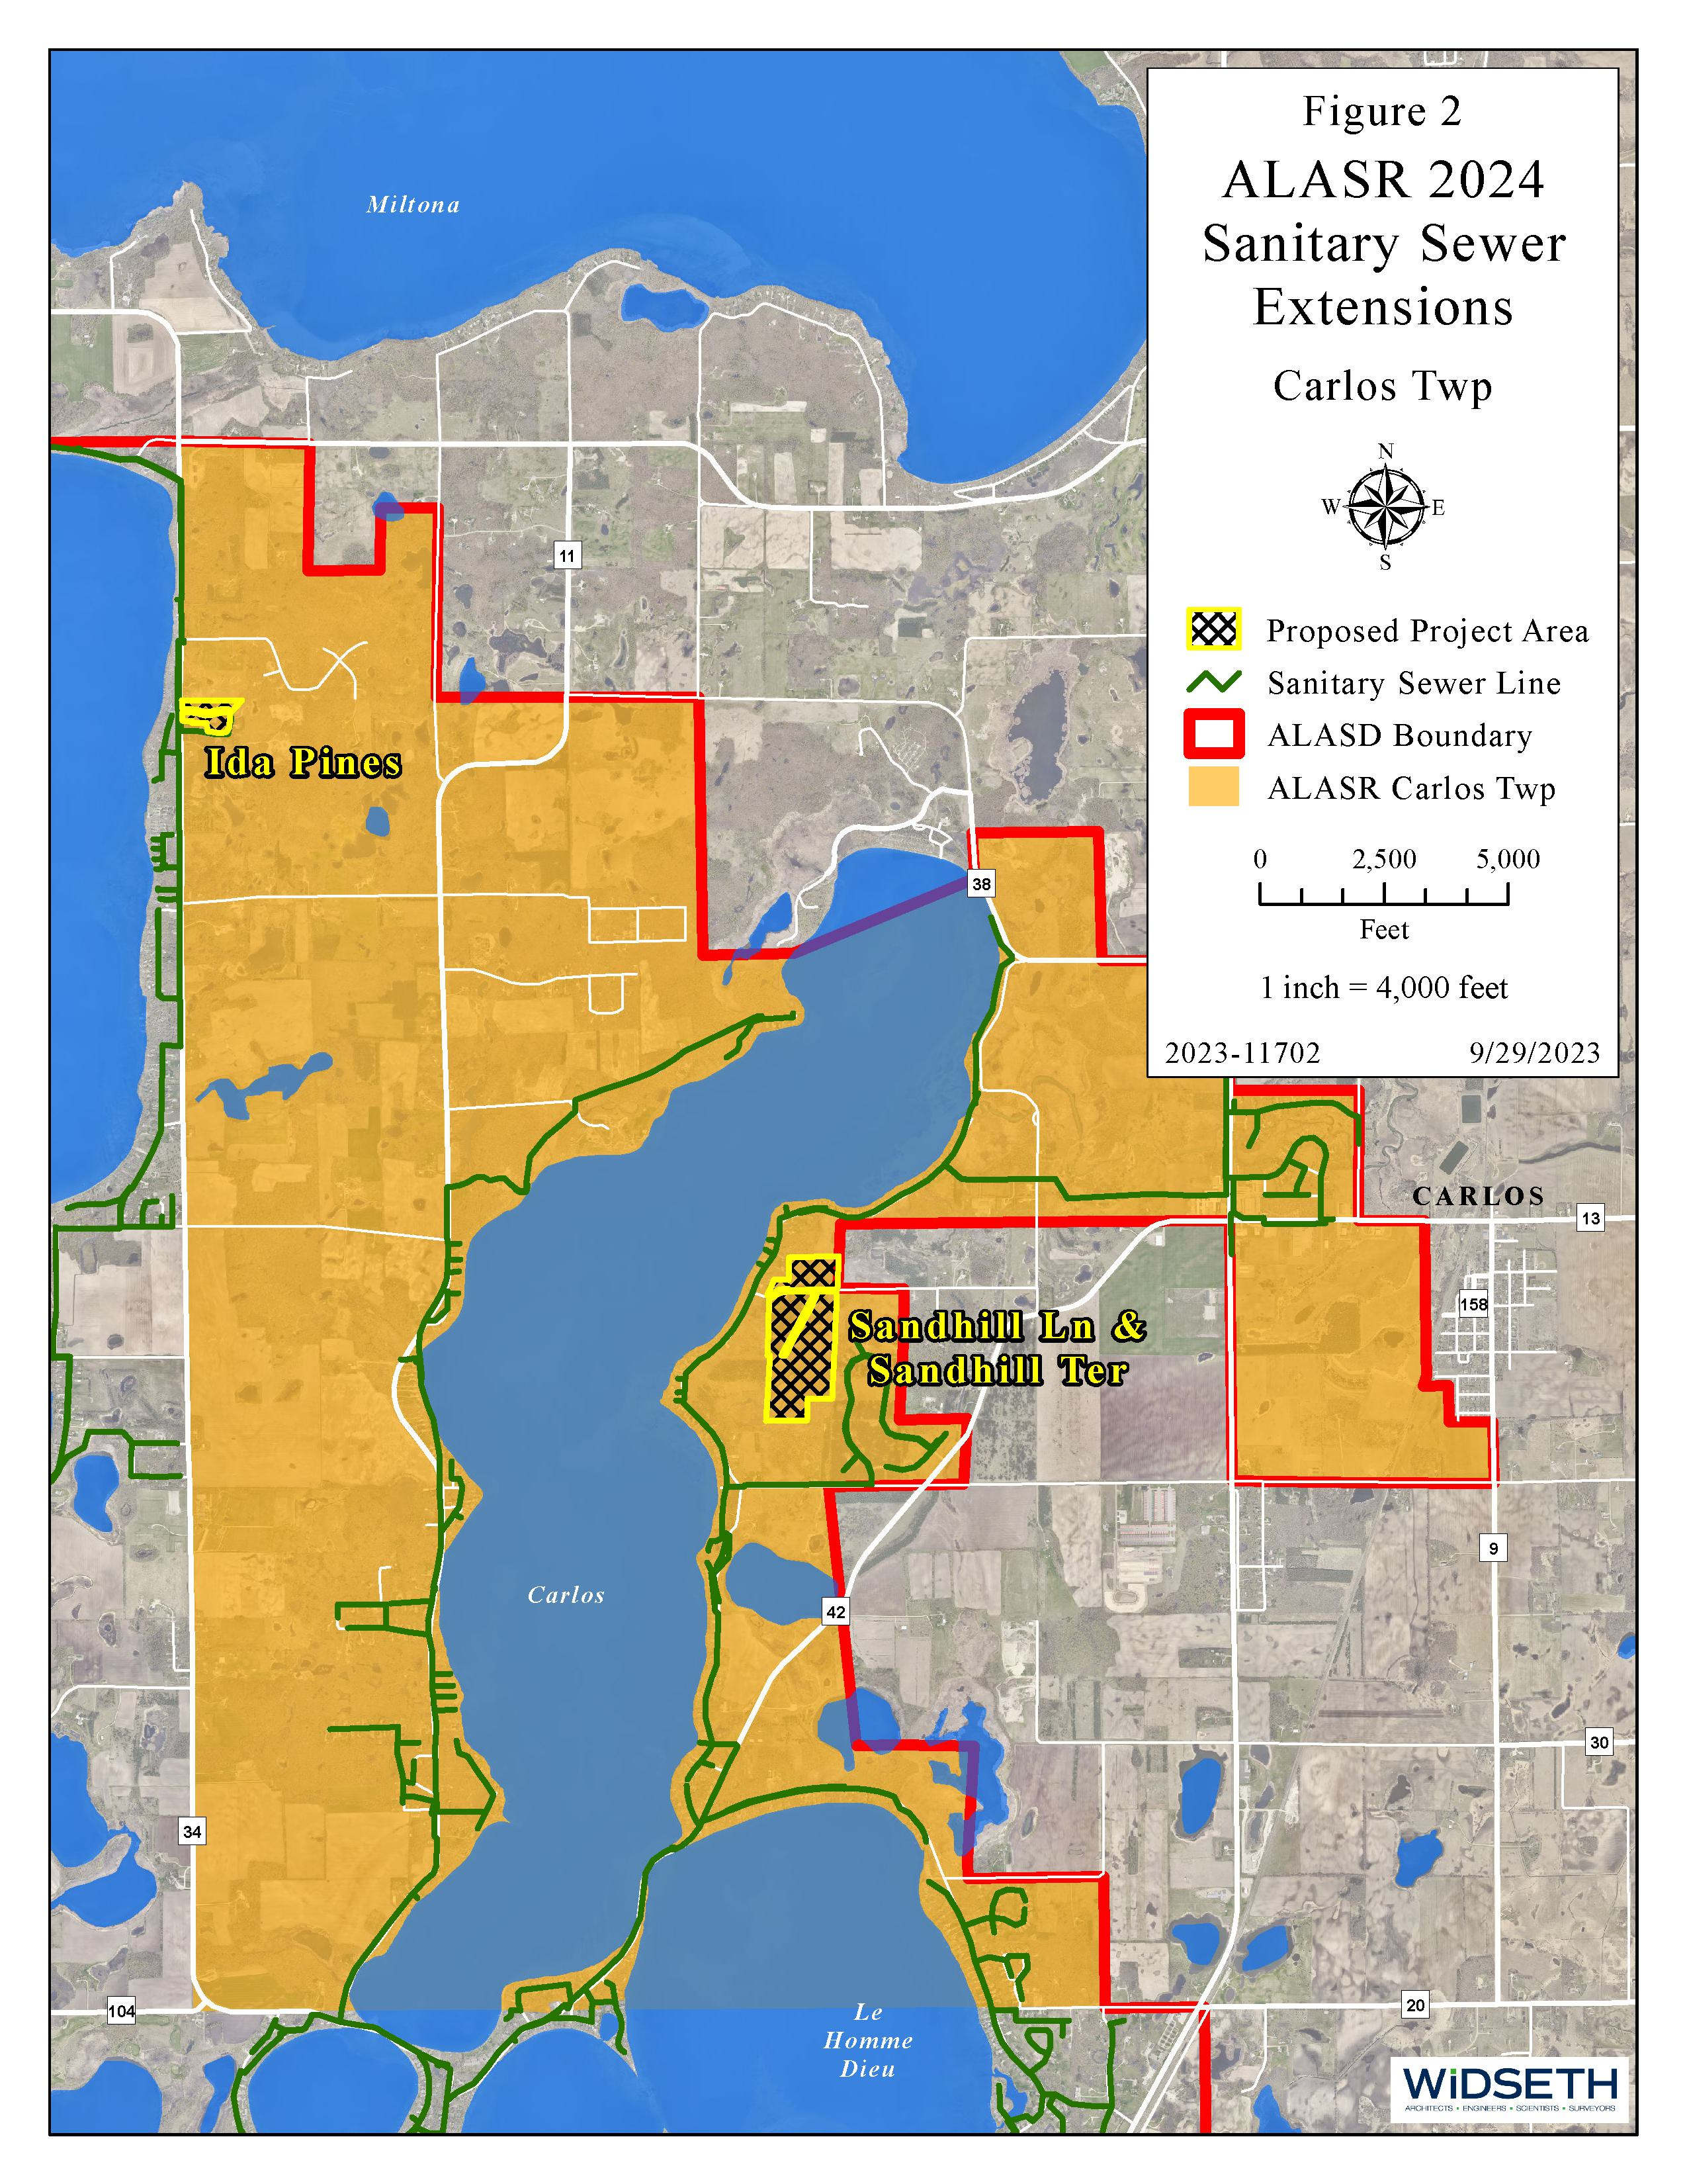
Carlos Township

Slide 9
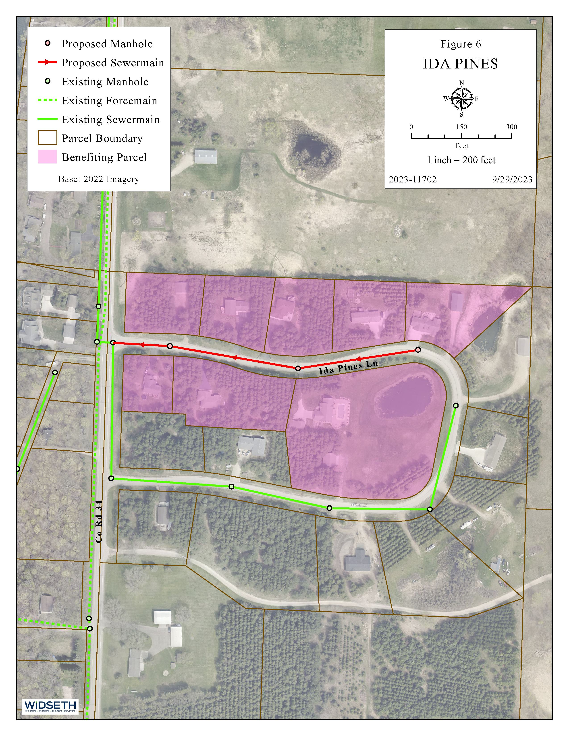
Ida Pines

Slide 10
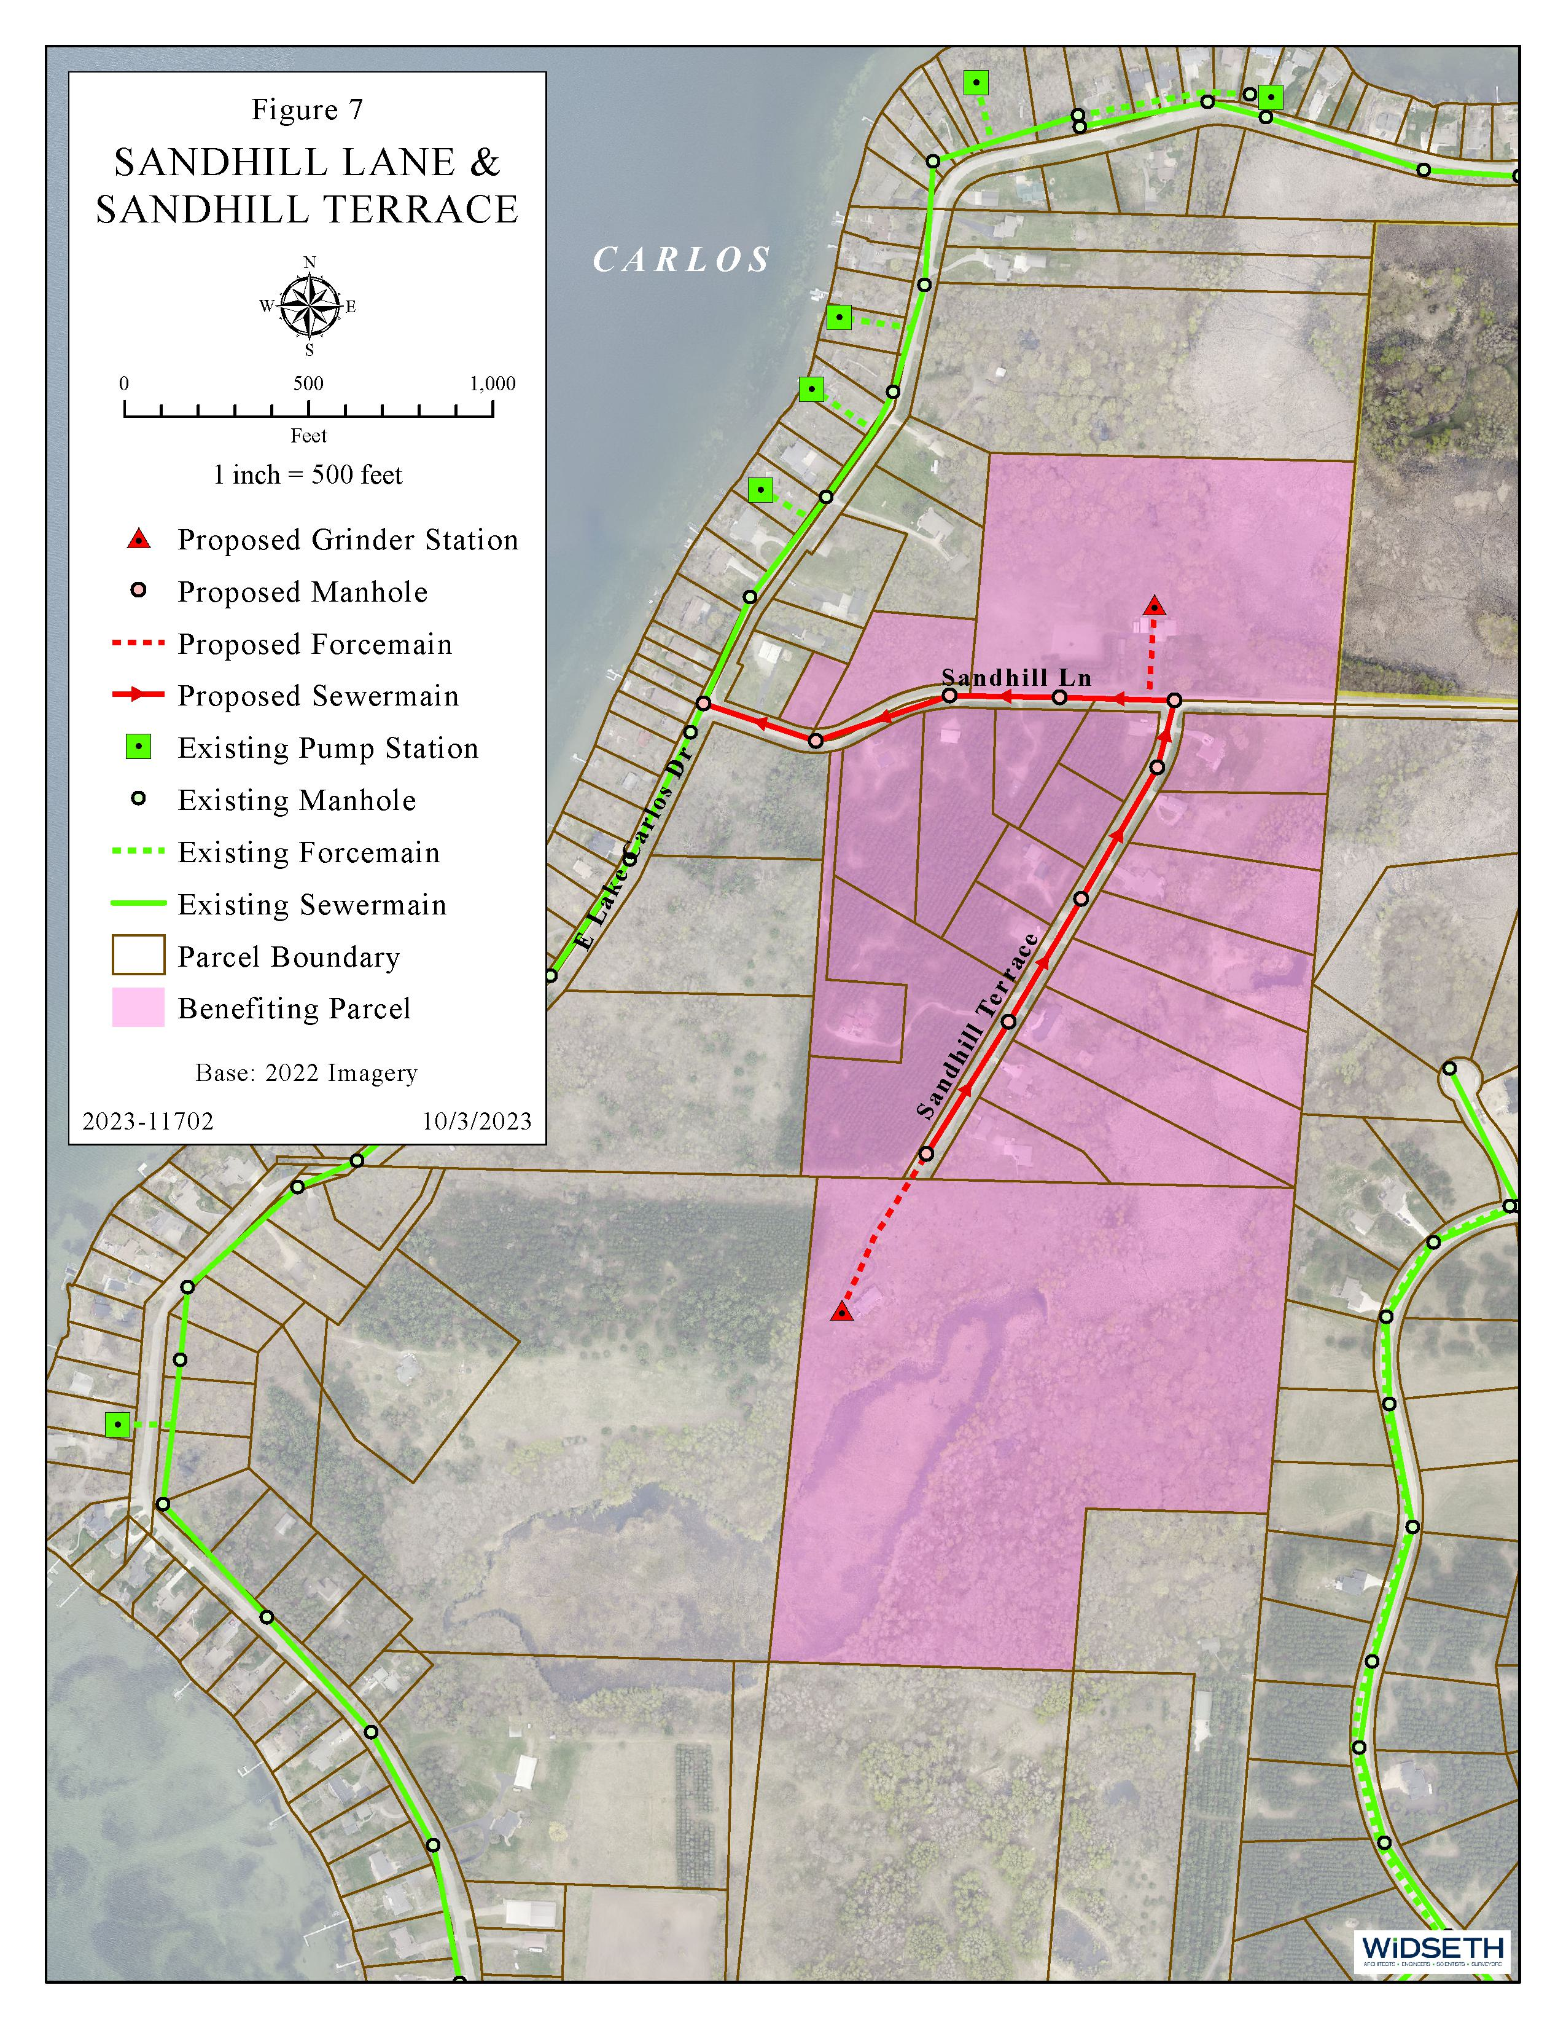
Sandhill Lane &
Sandhill Terrace

Slide 11
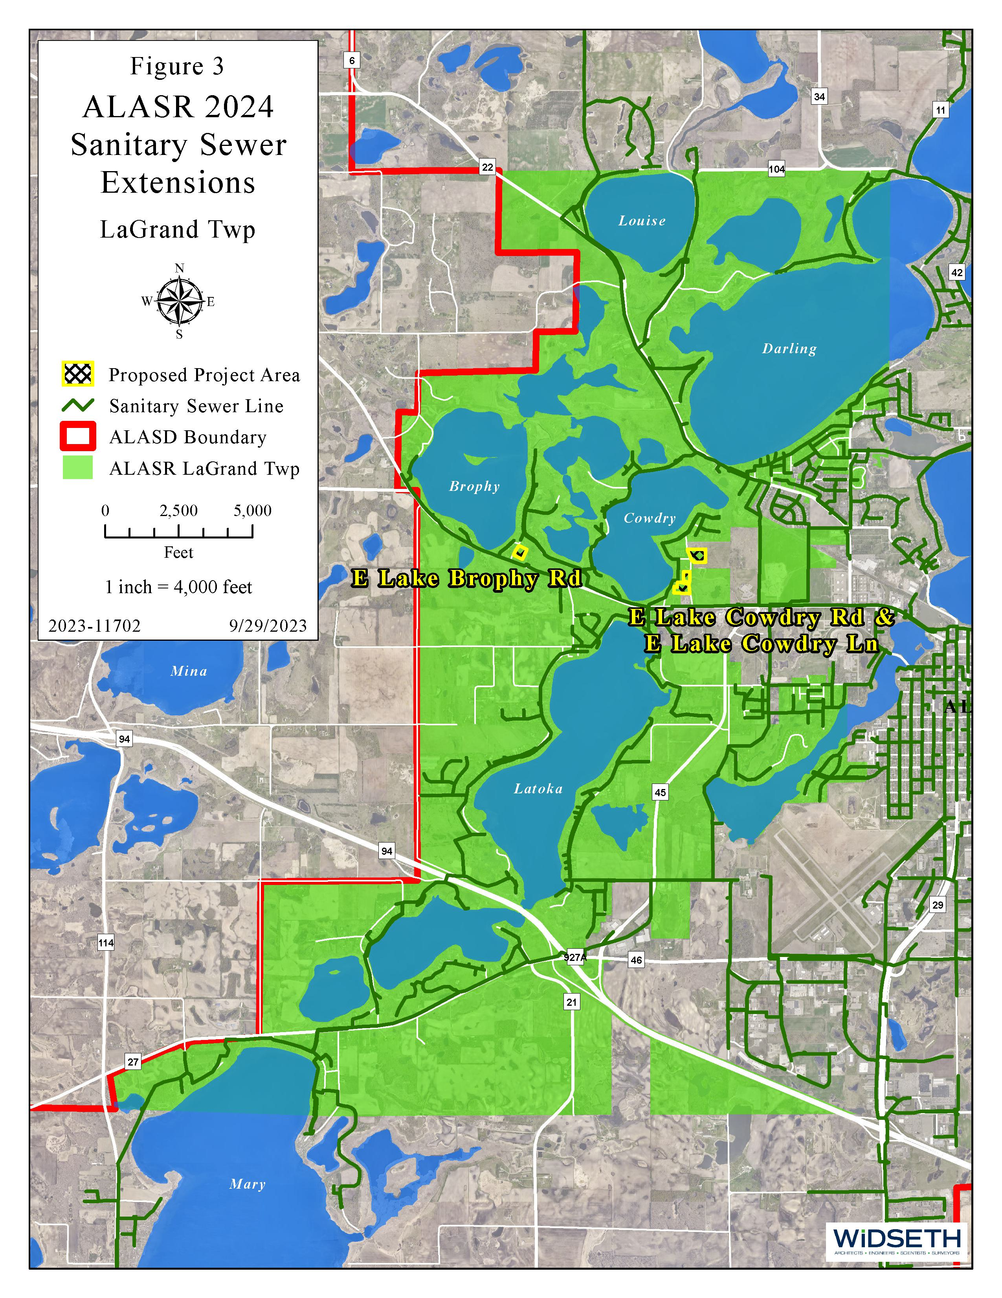
LaGrand Township

Slide 12
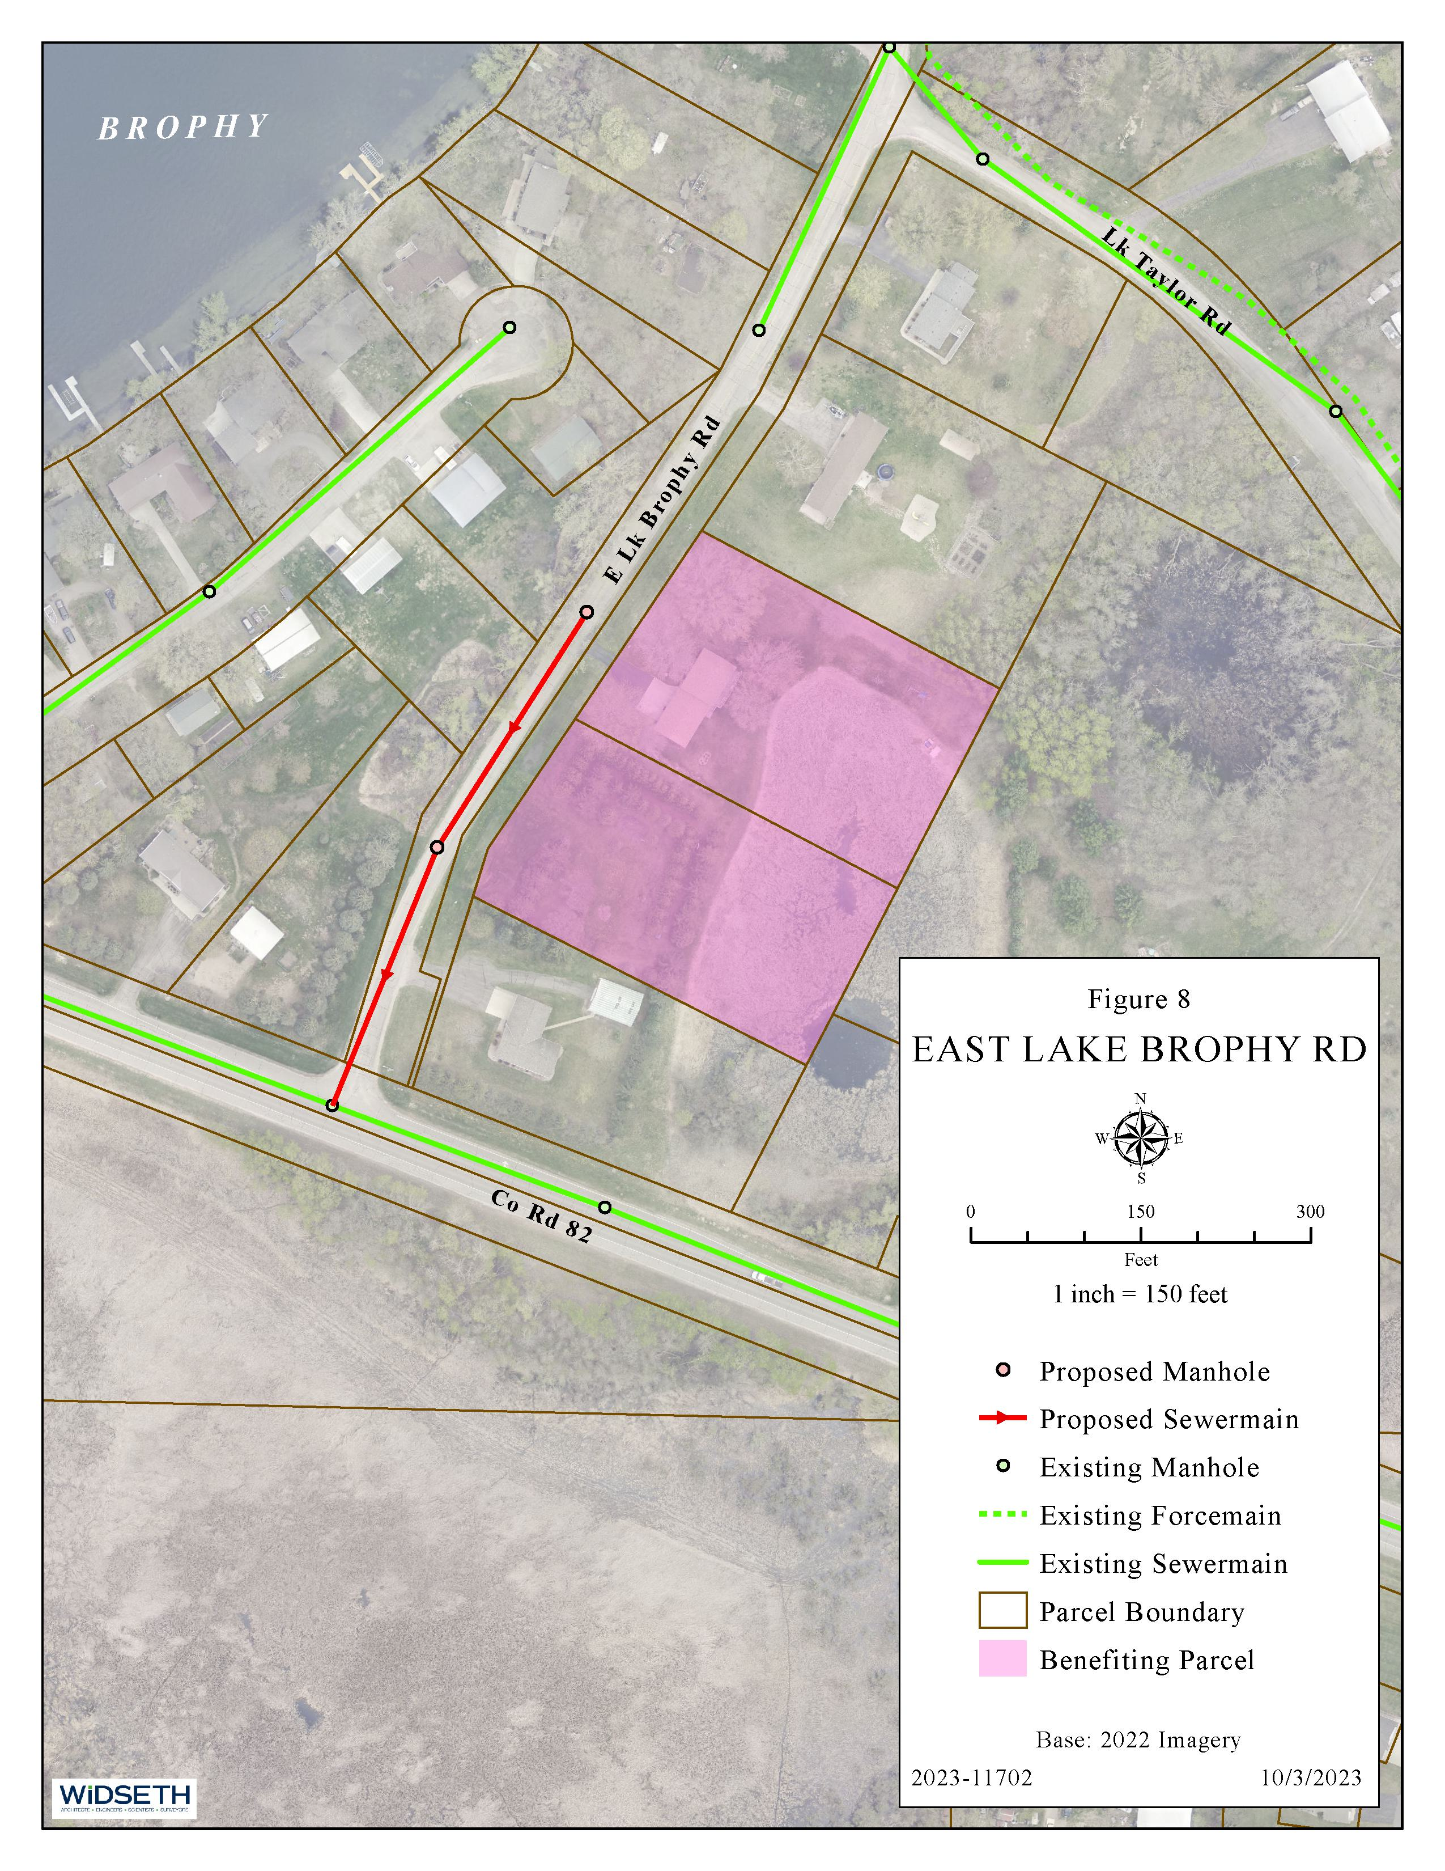
East Lake Brophy Road

Slide 13
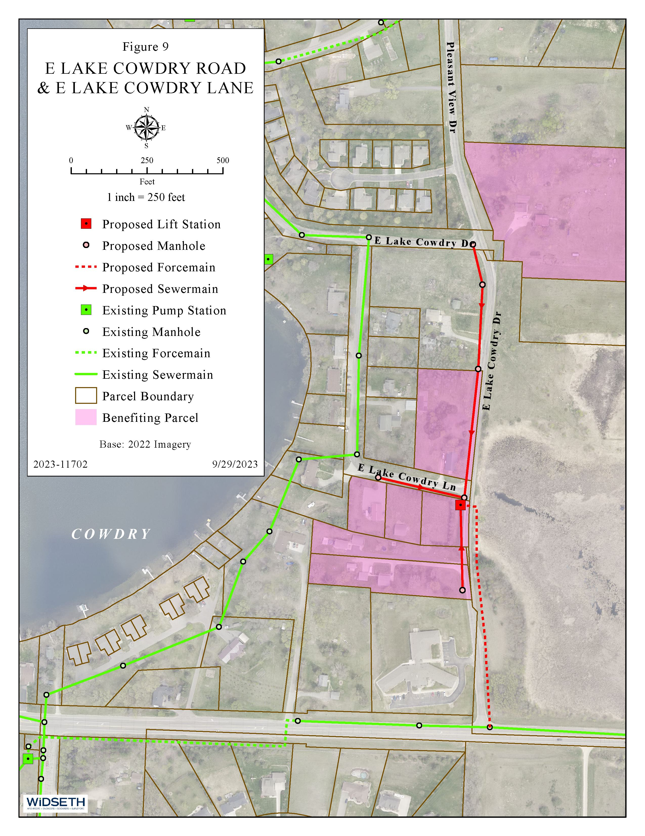
East Lake Cowdry Road & East Lake Cowdry Lane

Slide 14
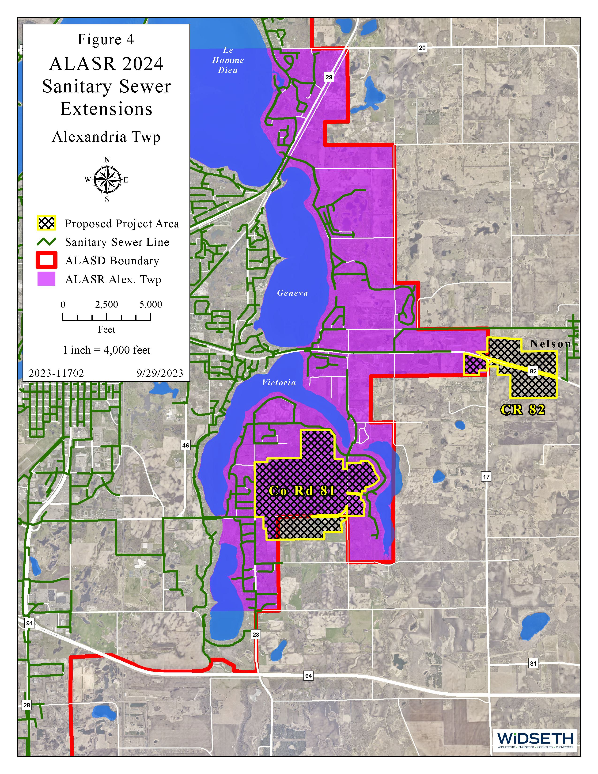
Alexandria Township

Slide 15
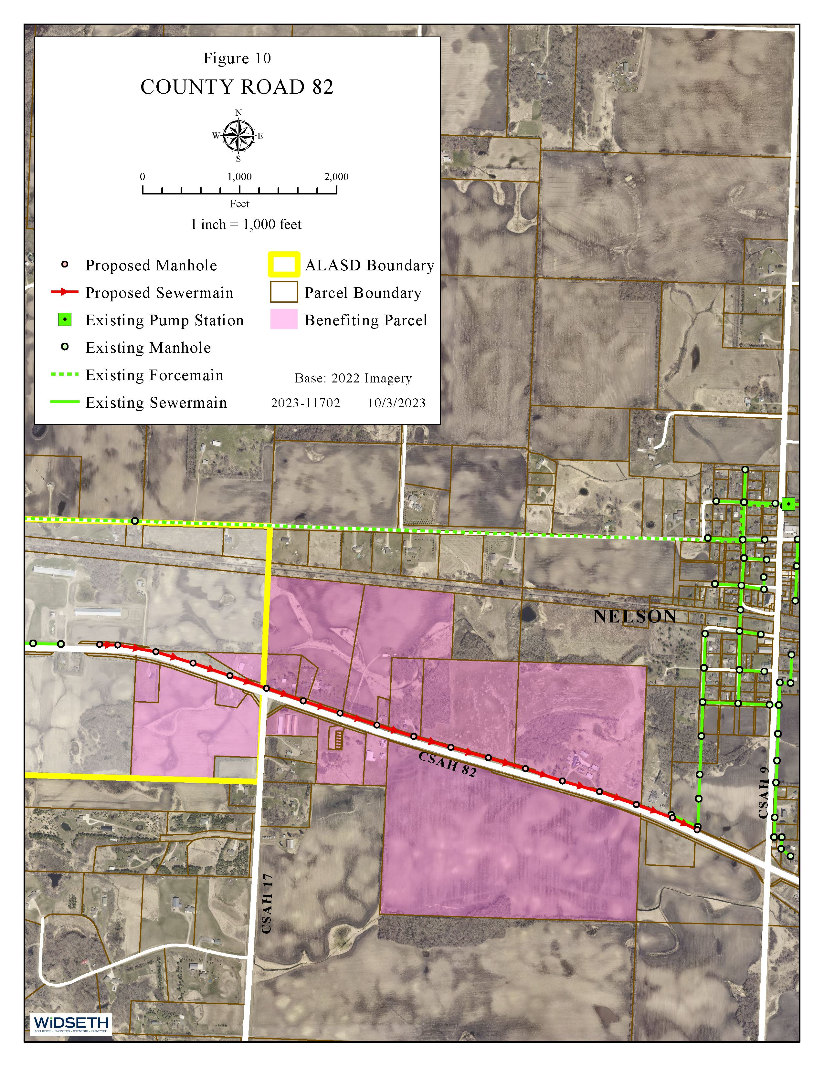
County Road 82

Slide 16
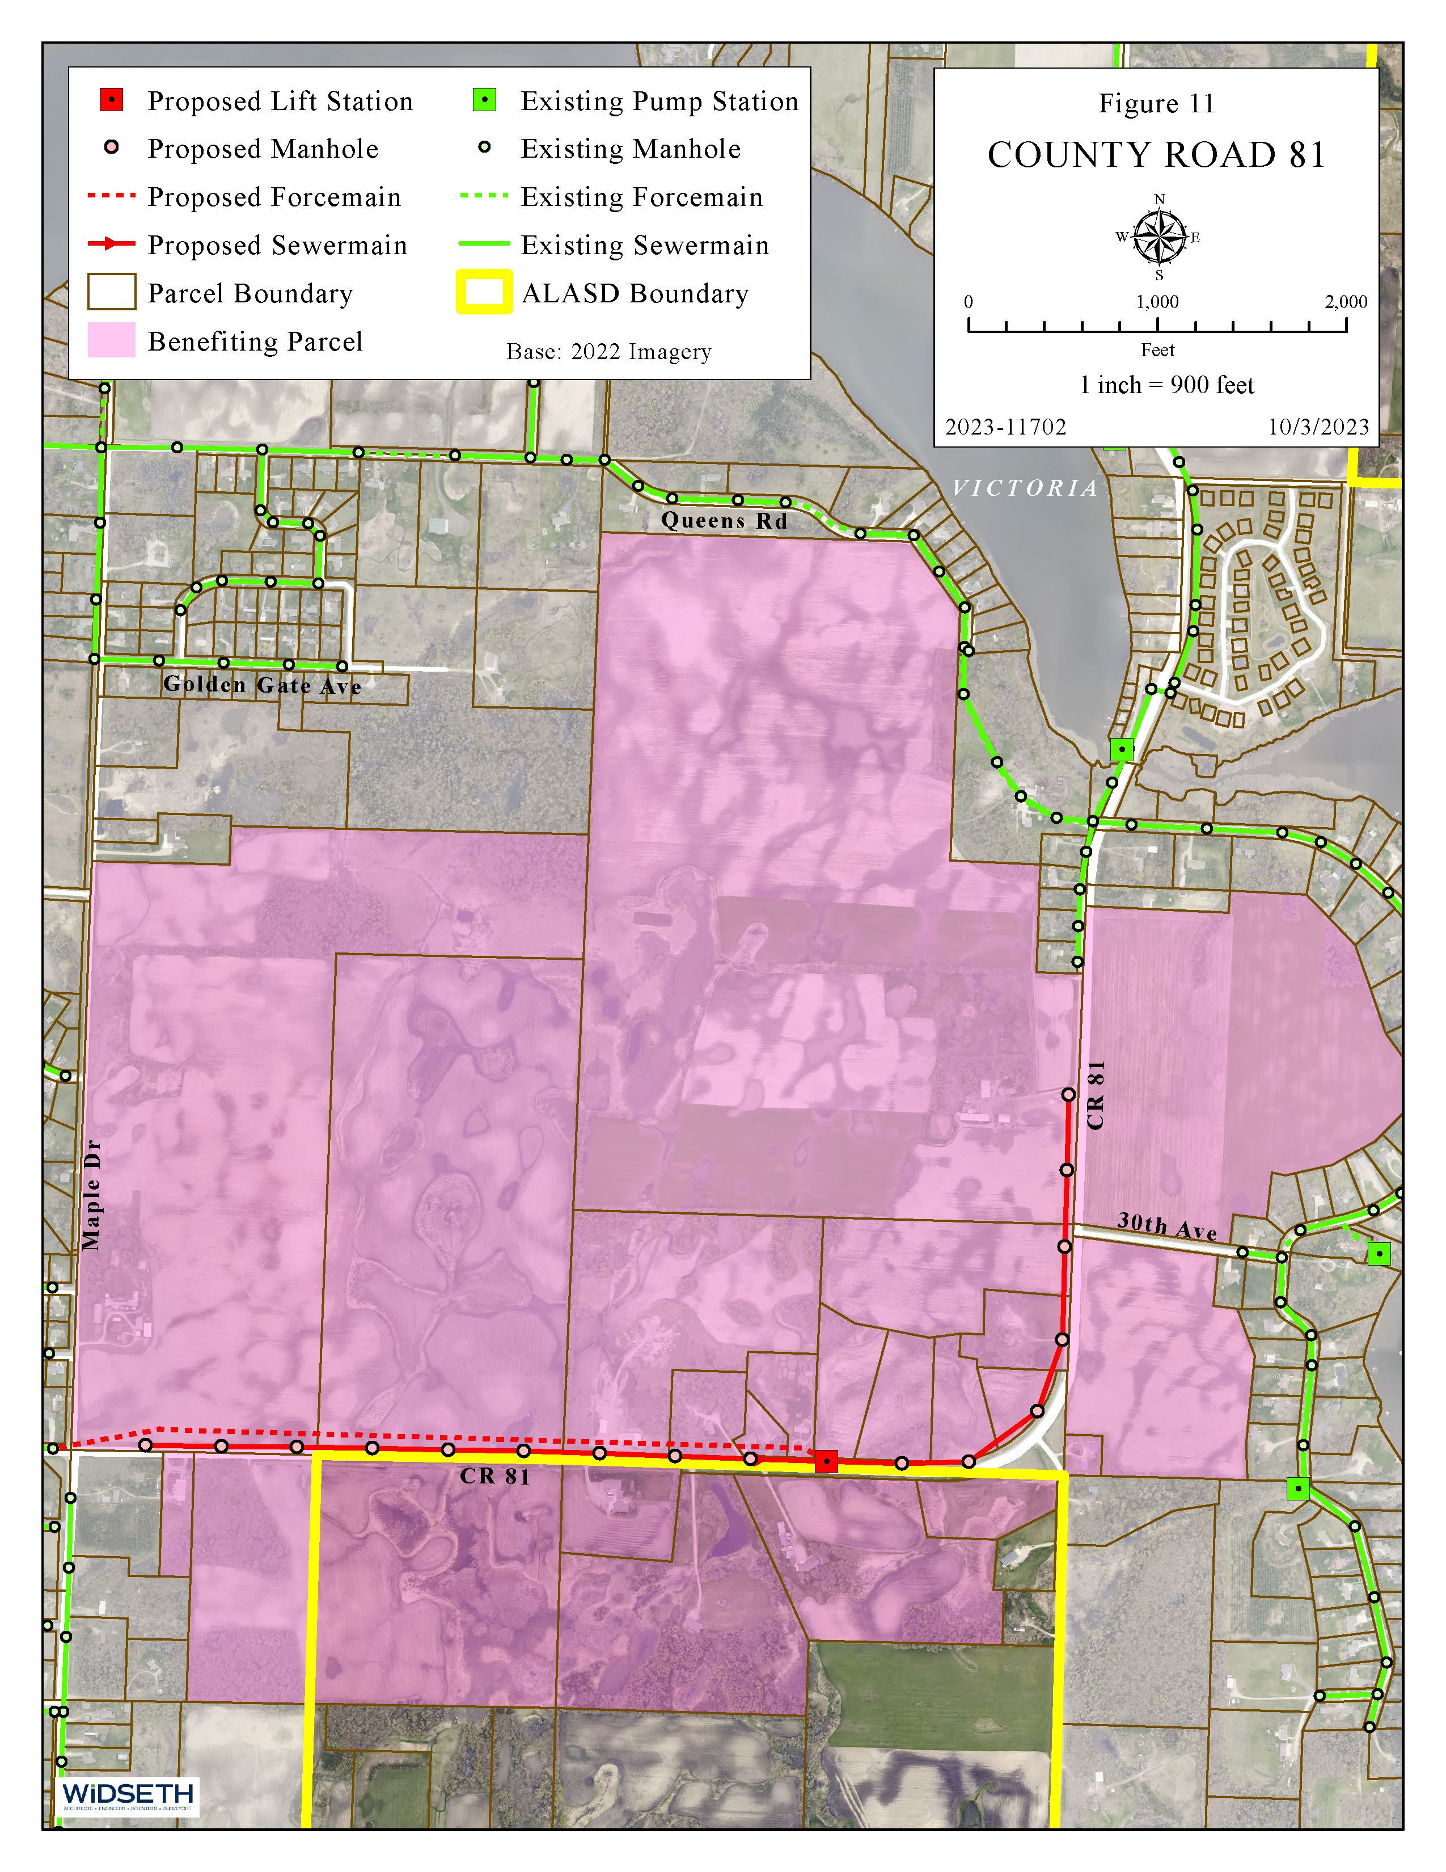
County Road 81

Slide 17
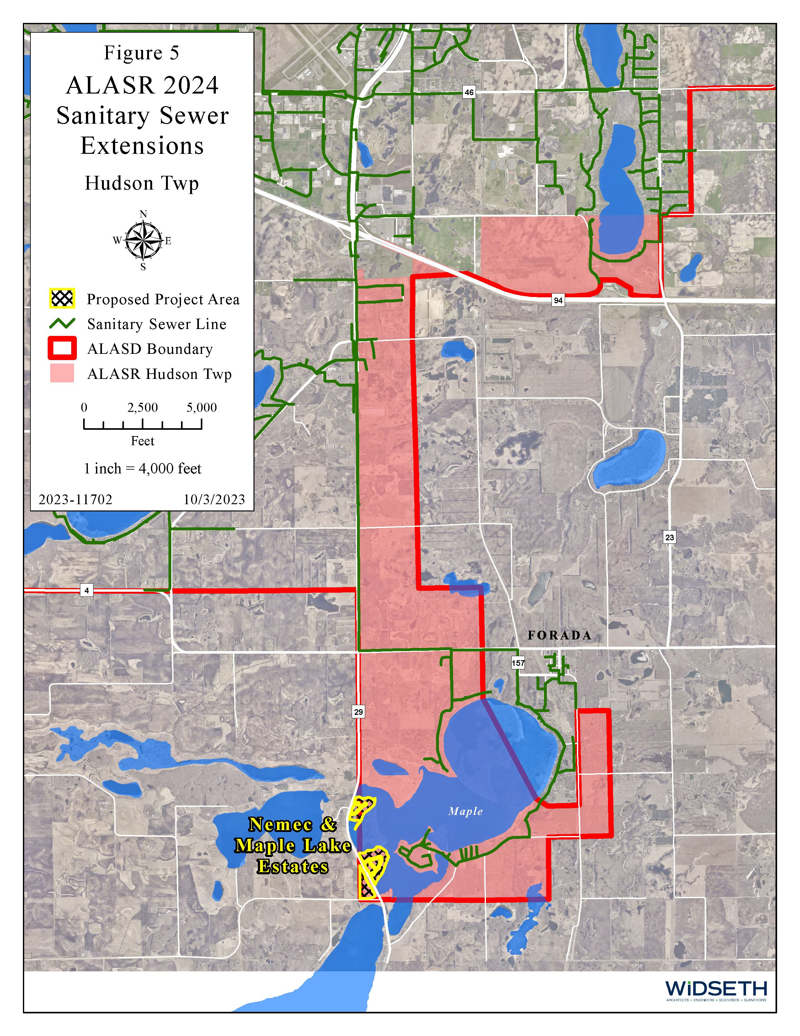
Hudson Township

Slide 18
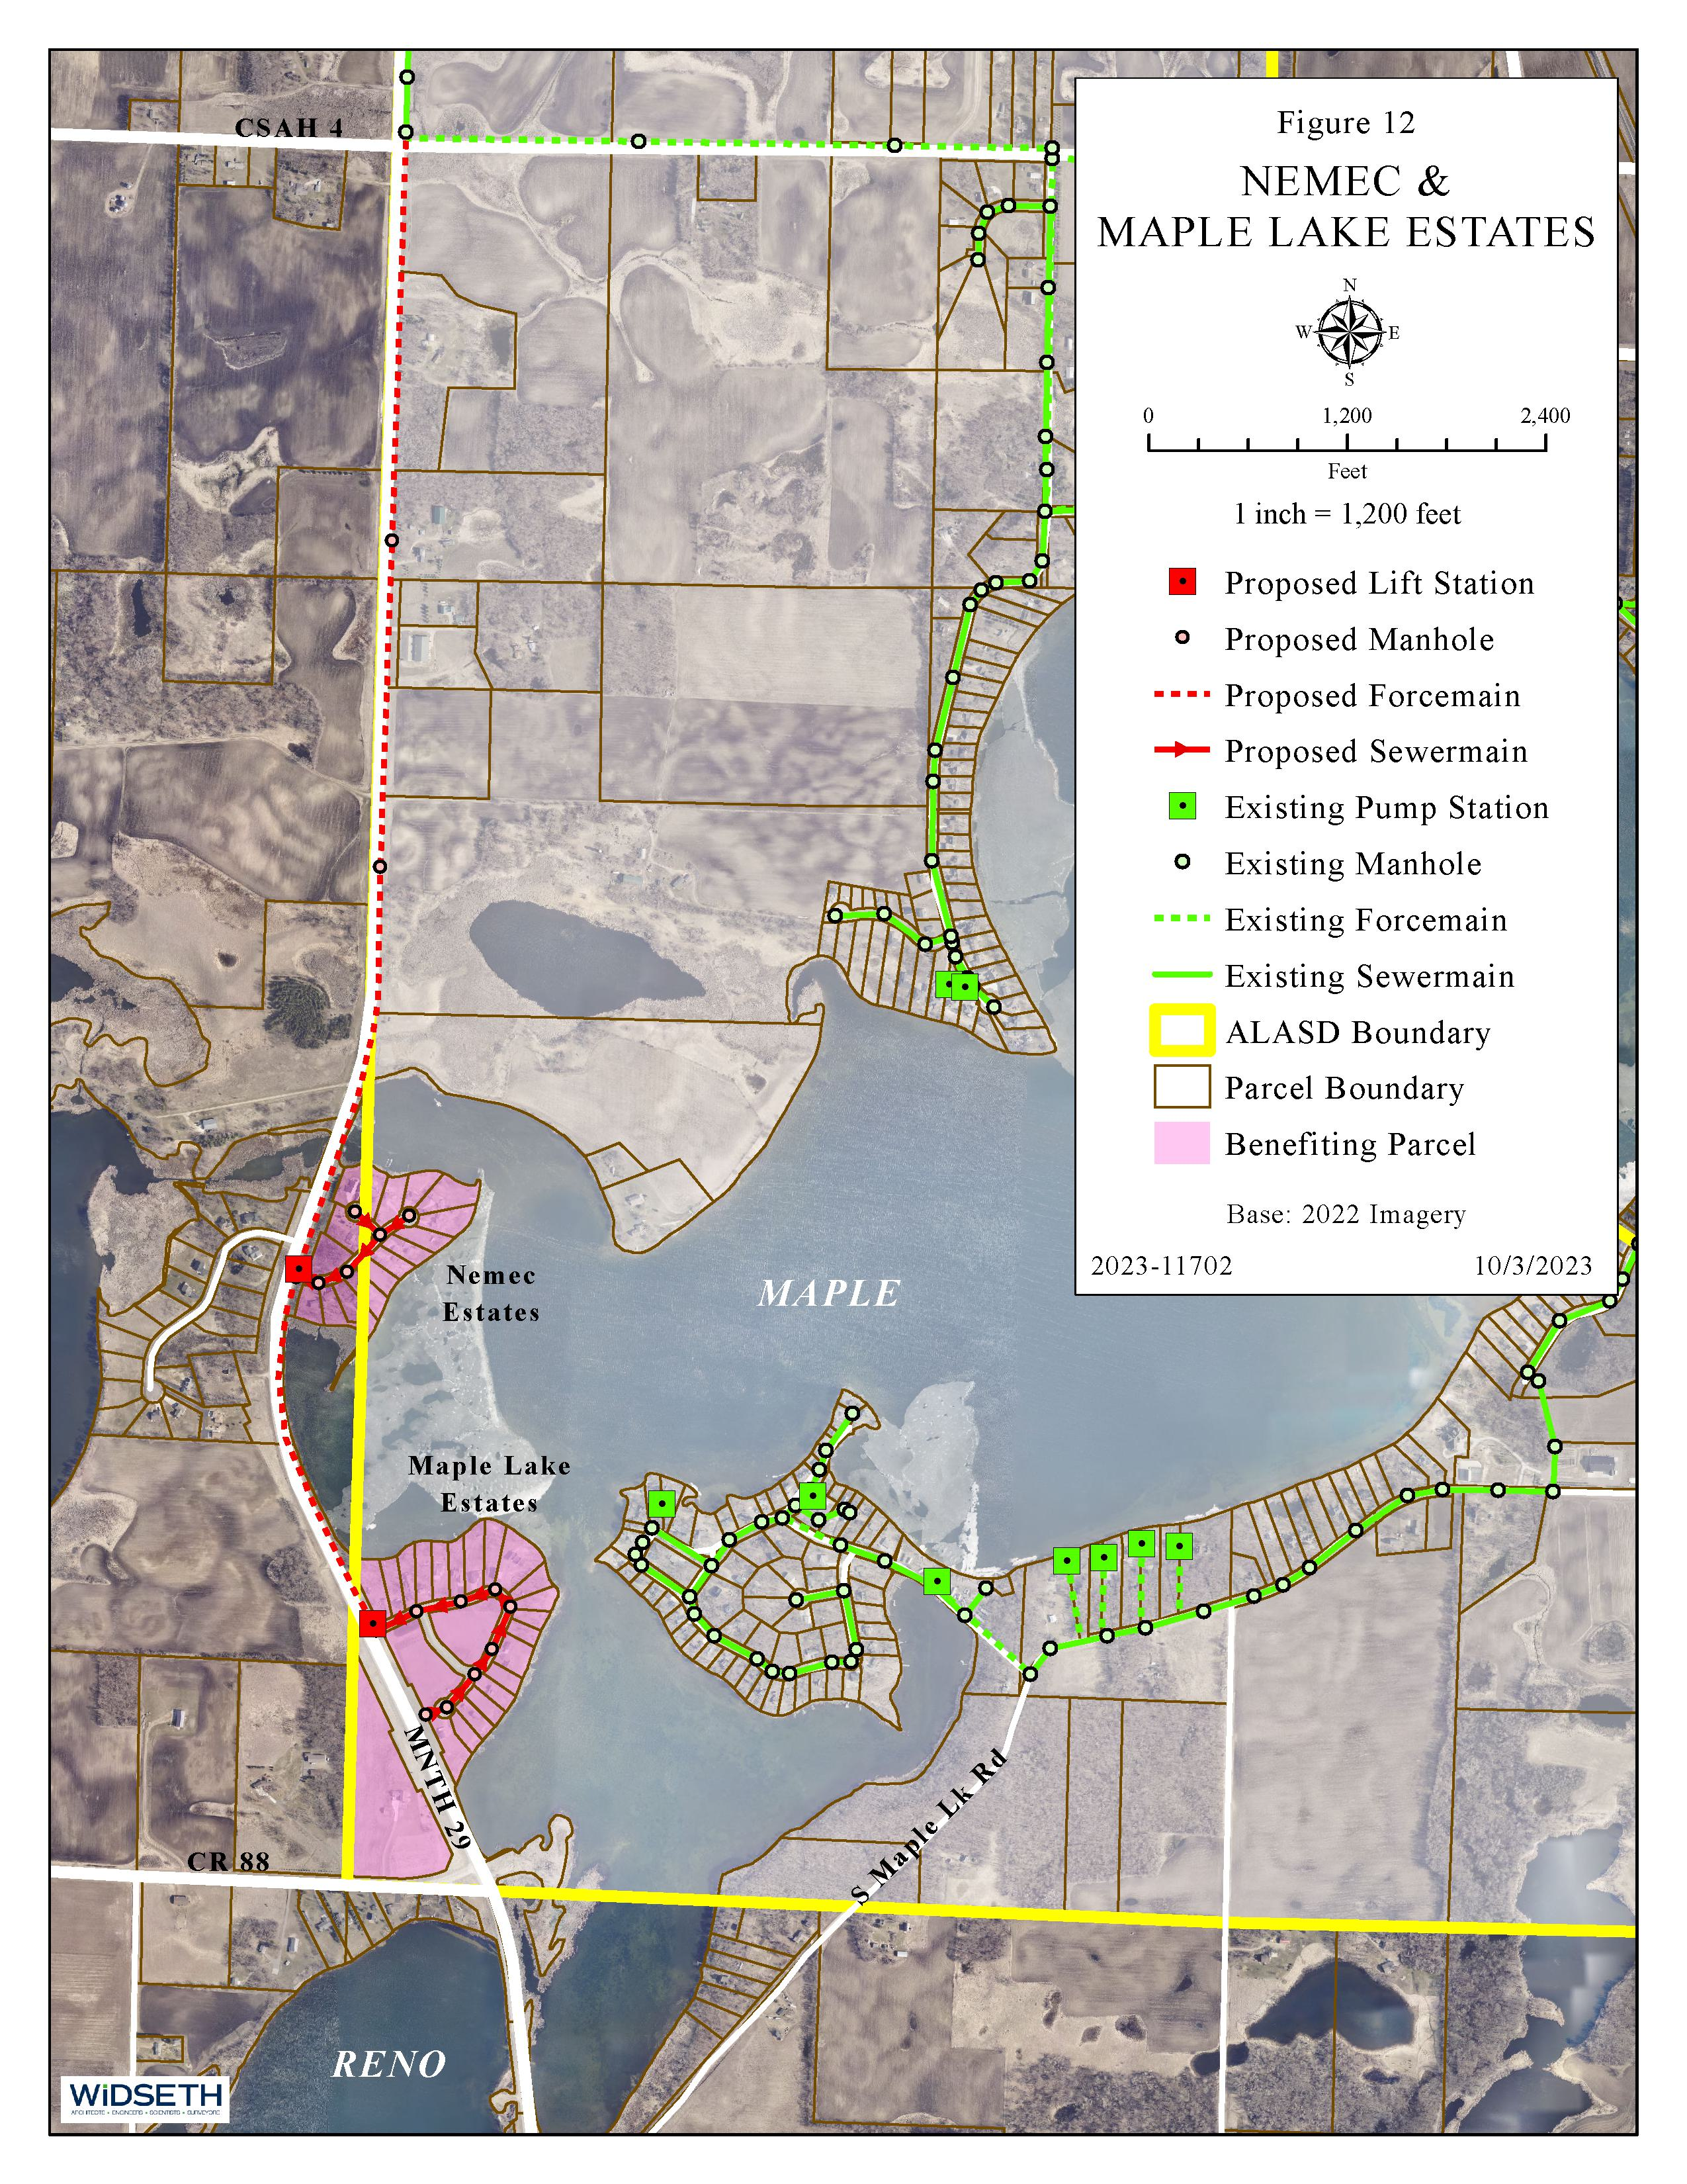
Nemec & Maple Lake Estates

Slide 19
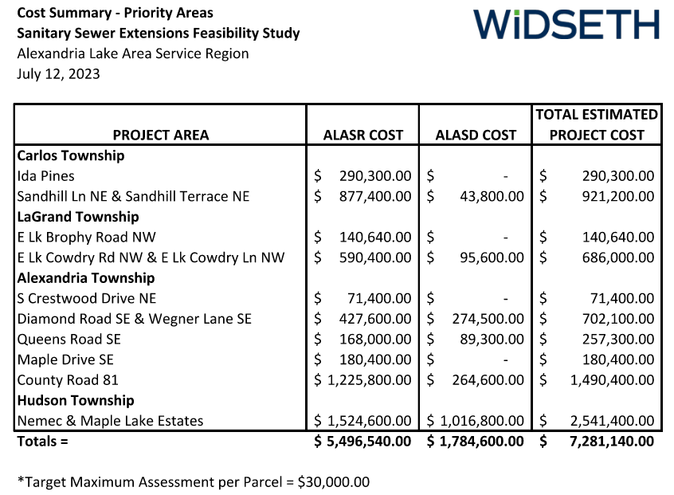
Proposed Project Cost

Slide 20
Sewer Service Stubs
Service stubs are installed to each property as part of the project
Typically installed to property line or easement line if sewermain crosses property to be served
Located to minimize cost to property owner when possible
Location determined between field representative and property owner
Location recorded by GPS and measured tie-ins to permanent physical features
Contractor will install riser pipe to assist finding stub when property connects
Stubs installed at sufficient depth to provide gravity service wherever practical

Slide 21
Sewer Service Stubs (cont’d)
Future stubs installed at sufficient depth to provide gravity service where feasible
E-One grinder stations will be provided when gravity sewer service is not an option
Depth of public sewer may need to be considered for construction of future structures if gravity service is desired

Slide 22
Surface Restoration
Restore disturbed surfaces to pre-disturbed condition
Additional improvements (i.e. paving an existing aggregate surfaced road) can be included in the project but would be at the cost of the roadway owner/authority
Sewer will be placed in public right-of-way whenever feasible
When sewer infrastructure needs to be placed on private property a permanent and/or temporary easement is obtained and the property owner paid for value

Slide 23
Property Owner Costs
Estimated Assessment = $30,000 (target maximum) at project completion
Target 20 years-certified by Douglas County
Property owner can pay assessment in full at any time
ALASD WTEF fee = $2,500 at time of connection, submitted with sewer construction permit
Construction of private service line between residence and stub at property line and abandoning of existing septic system
Cost depends on length, depth and surface restoration

Slide 24
Project Funding
Project funding sources:
General Obligation (GO) bond
Invested cash reserves (ALASR will use existing reserve funds to help reduce assessments)
The ALASD recently issued and secured a GO Facilities Bonds, Series 2023
Proceeds of the Bonds will finance ALASD facility improvements and ALASR Sanitary Sewer Extension project
The ALASR will reimburse ALASD for their share of the 2024 Sanitary Sewer Extension Project costs by:
Special assessments
Future connection charges

Slide 25
Benefits to Property Owners
ALASD will operate, maintain, and replace collection system going forward
No additional direct replacement cost to property owners for replacement
Lifespan of properly installed, well maintained compliant septic systems is approximately 20 years vs lifetime
Remove septic system, holding tanks, etc.
No more maintenance
More usable property – free up setbacks and drain-field restrictions
Land use options viable for commercial opportunities
Increased property value

Slide 26
Sewer Connection Ordinance
How will future connections to installed sewer be addressed versus previously assessed/benefitted properties?
Connection Charge
Sewer Access Charge (SAC)
Mandatory Connection Policy
Significant infrastructure investment, parcels abutting public sanitary sewer required to connect
Time period for connection is typically one to three years
Time period for connection typically extended to five to seven years for compliant septic systems with certified inspection documentation

Slide 27
Public Hearing Guidelines
Discussions will be limited to the stated purpose of the hearing
Anyone wishing to comment or ask questions will be allowed to do so
No person may speak a second time until everyone has had an opportunity to speak at least once
If time allows, each person shall have the opportunity to speak a second time
No speaker will be permitted to speak more than twice, except to answer questions from the board
Each speaker will be limited to a total of approximately three minutes for each opportunity to speak
A response elicited by a statement or questions of the speaker shall count toward the three-minute time limitation, unless it is an extended response
No applause, interruptions, abusive language or personal attacks will be allowed
Such conduct shall be sufficient for the moderator to rule a person out of order ending that individual's opportunity to speak further

Slide 28
Public Hearing Guidelines (cont’d)
All comments by the public must be directed to the moderator
Each speaker must state his or her name, address, and the group he or she represents, if any, before speaking
The board may ask questions of the speakers
Thank you for your attendance and participation!

Slide 29
Contact Info
Scott Gilbertson, ALASD Executive Director
320-762-1135
scott@alasdistrict.com
Bryan Bye, PE, Widseth
320-335-5051
bryan.bye@widseth.com

Slide 30
Questions/Comments

